Slide 1
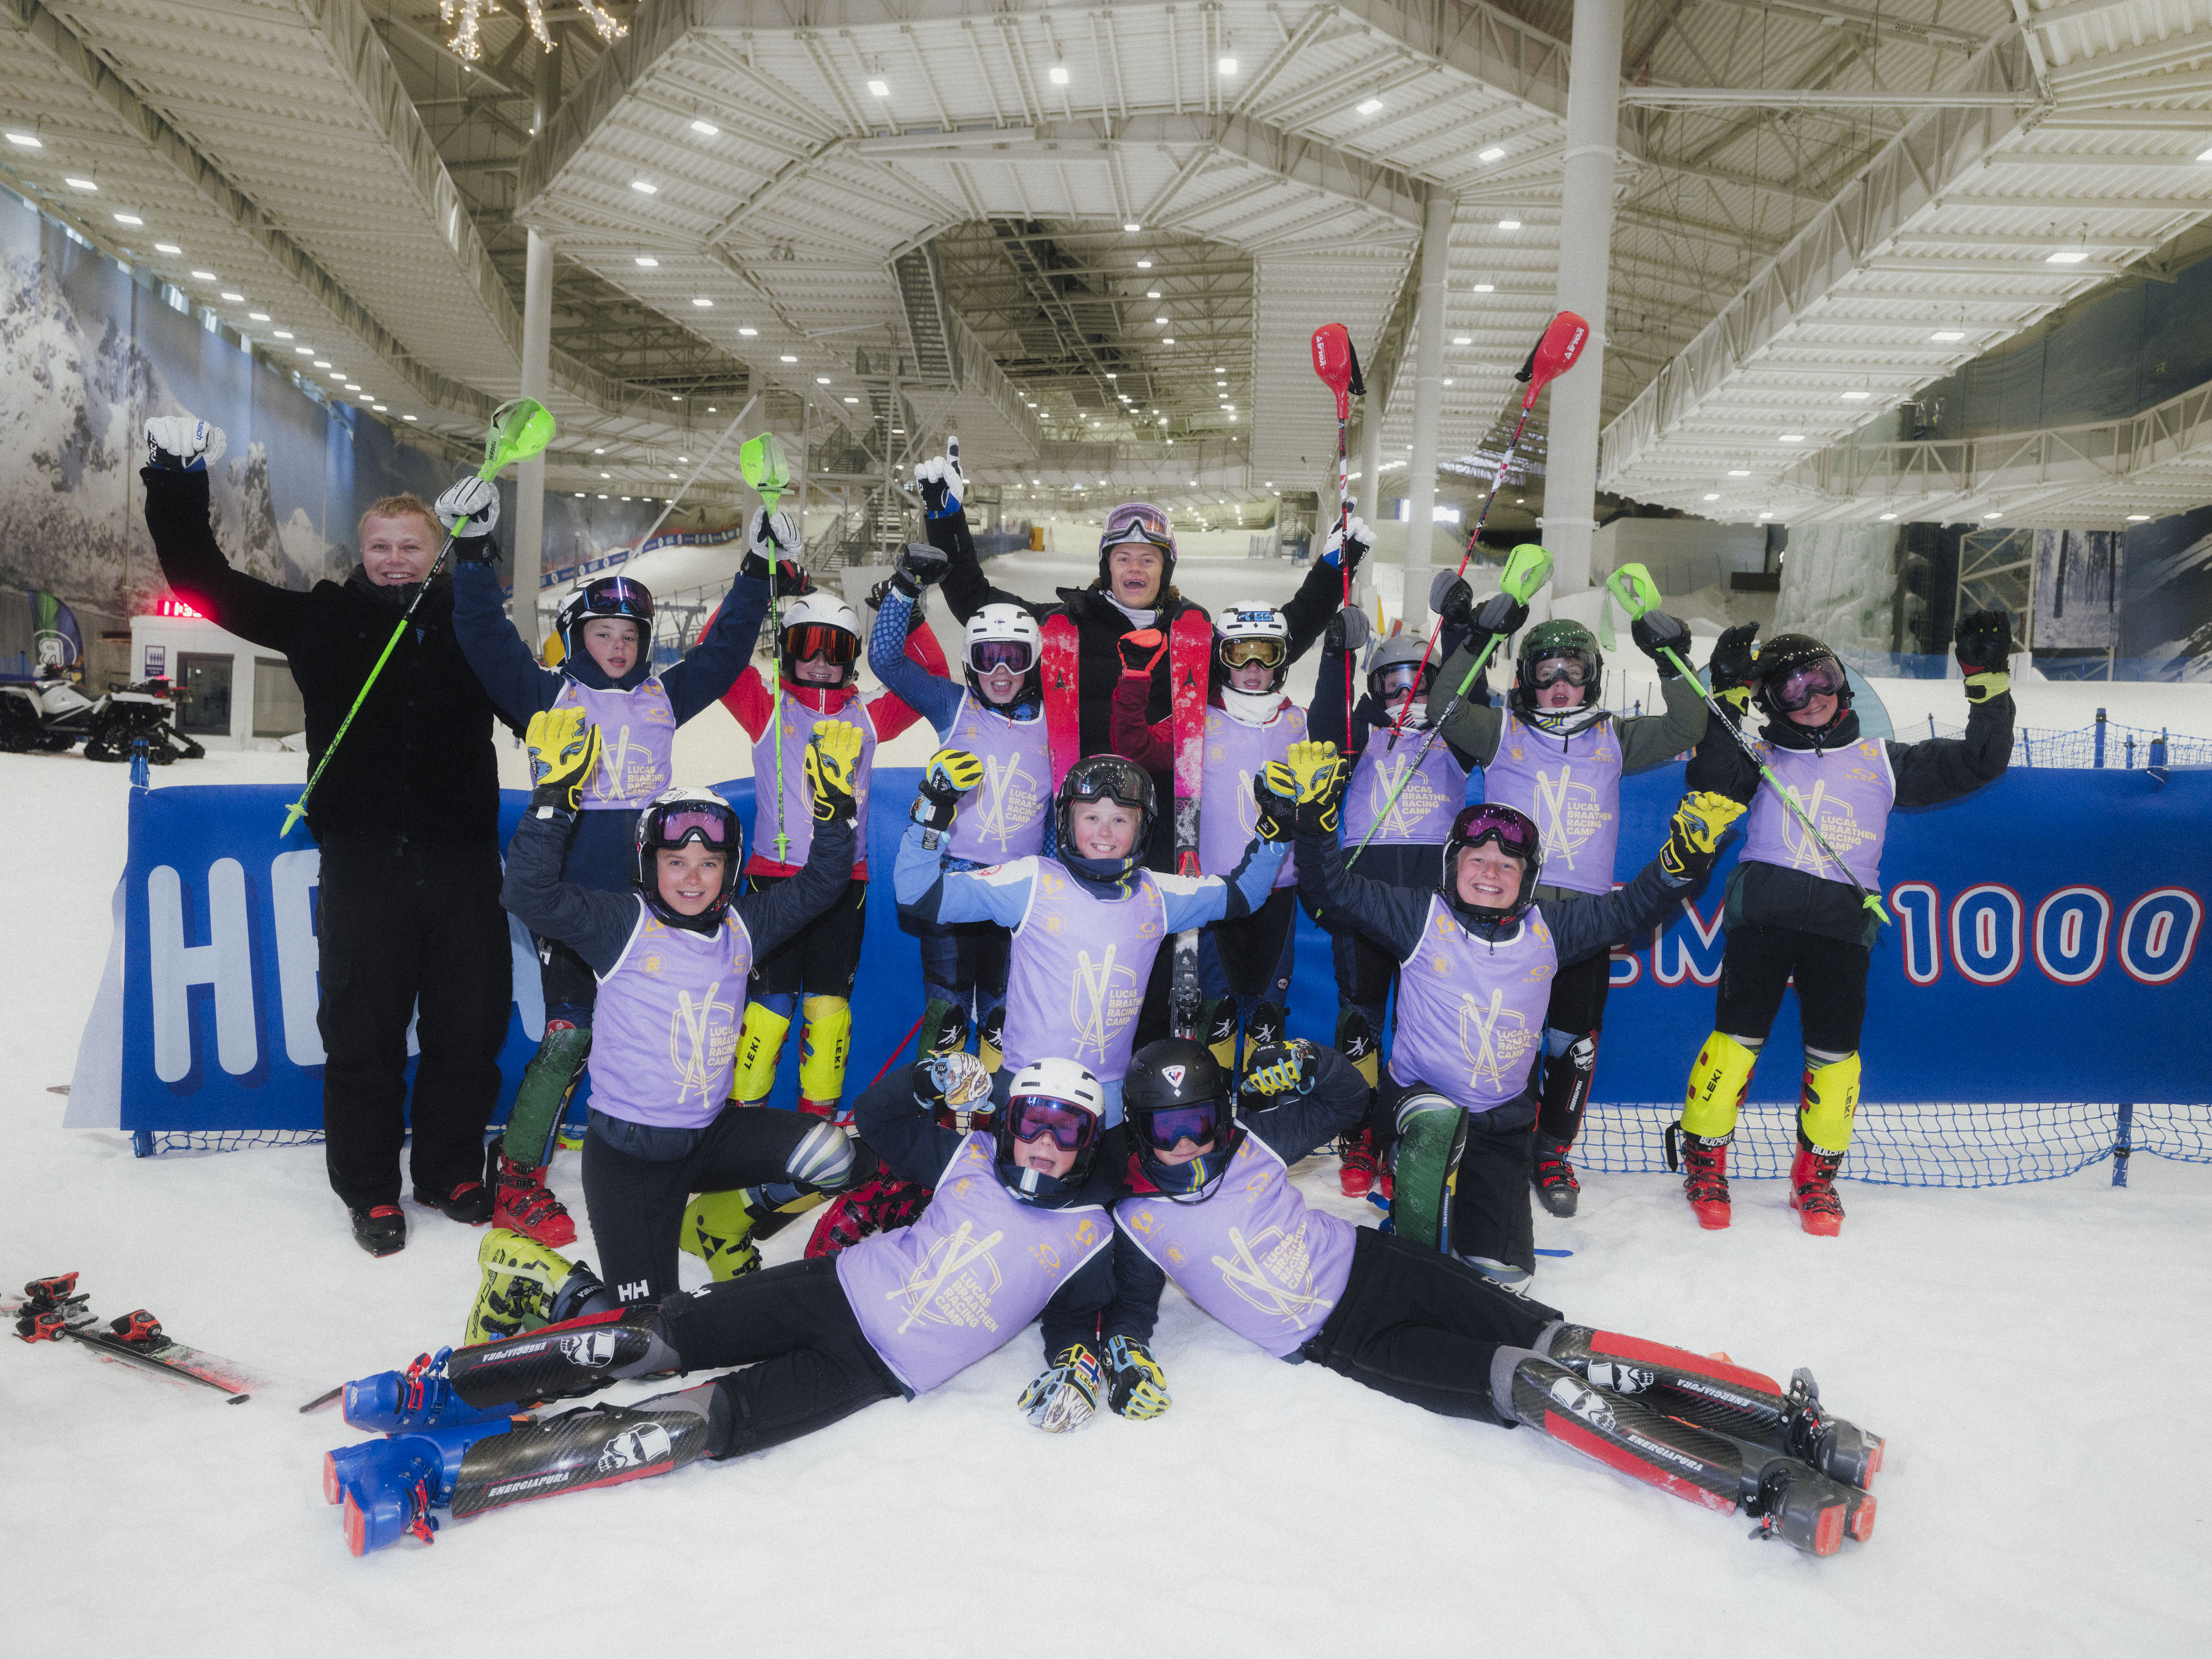


PROGRAM

Slide 2
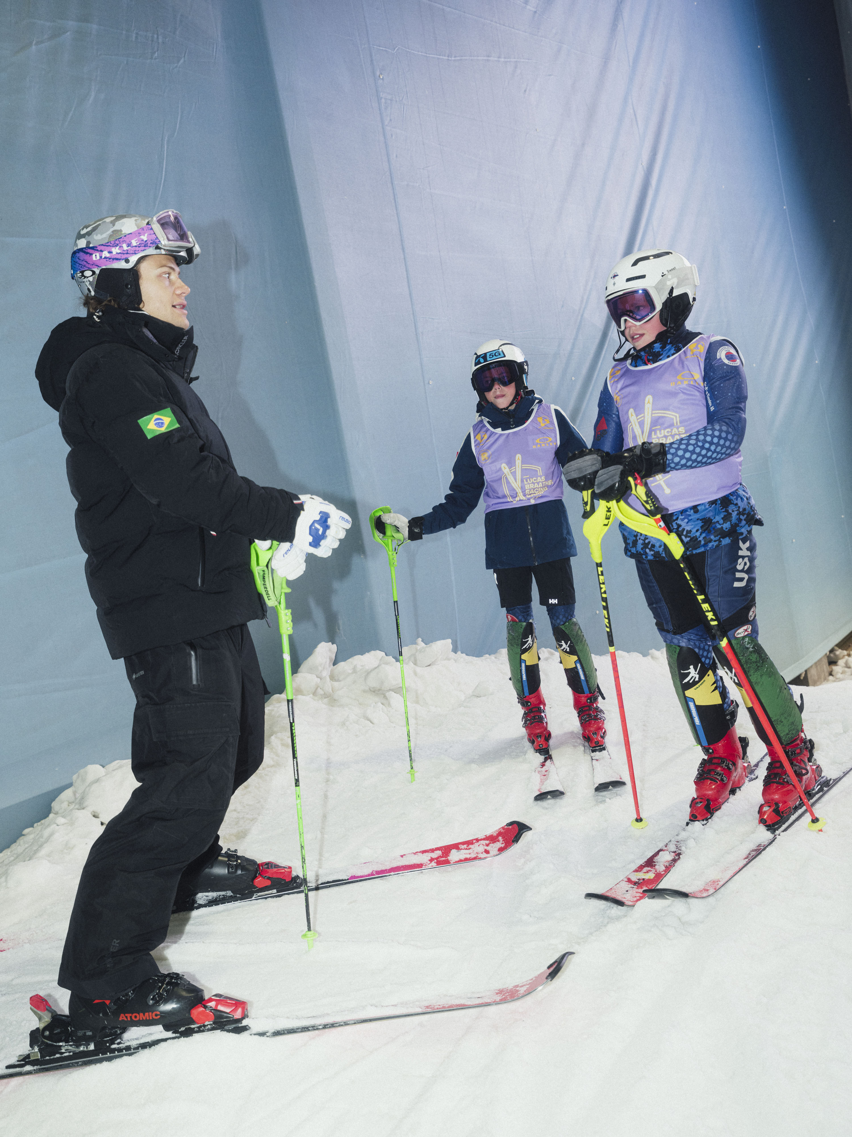
DAY 1 Friday
TIME RACE CAMP SCHEDULE ACTIVITY
13.00 – 14.30 SKI TRAINING GROUP 1 & 2 15.00 – 16.30 SKI TRAINING GROUP 3 & 4
2

Slide 3
DAY 2 SATURDAY
TIME RACE CAMP SCHEDULE ACTIVITY
1 SESSION SKI TRAINING
1 SESSION TRAMPOLINE TRAINING
1 SESSION ICE CLIMBING
1 SESSION PLAY IN SNOW DOME
THERE IS SKI TUNING CLASSES FOR THE PARENTS.
DAY STARTS AT 10.00.
TOTAL OF 4 GROUPS.
LUNCH AND DINNER WITH LUCAS ON SATURDAY
LUCAS HOLDS A SPEECH DURING THE DINNER.
3

Slide 4
DAY 3 SUNDAY
TIME RACE CAMP SCHEDULE ACTIVITY
10.00 – 11.30 SKI TRAINING GROUP 1 & 2 12.00 – 13.30 SKI TRAINING GROUP 3 & 4
4

